Slide 1

WIJP

Slide 2
MOTTO
“LIGHTENING THOSE WHO ARE HEAVILY BURDEND”

Slide 3
REGISTRATION DETAILS
Number 135 – 938
Address: 5148 Maake drive Riverside Mogale City 1754
Email: walkablejourney@gmail.com
Website: www.wjip.org.za
Tel: 073 – 481 7595

Slide 4
BACKGROUND
Initially the objectives of Walkable Journey is to focus on Cancer and empowerment as there is very little support and knowledge.
Main purpose will include counselling, education, foods distribution and material necessities.

Slide 5
BACKGROUND……..
Walkable Journey It is a registered non-profit organisation (NPO) that prides itself on offering a social responsible practical solution to the CANCER infected and affected beneficiaries that range from home based care, orphans care, disability care hospice, food production and feeding scheme, skills development and training.

Slide 6
BACKGROUND……..
It is an exhilarating and inspiring organization with an in-depth understanding of the African community basic social, physical, spiritual, emotional and health needs.

Slide 7
VISION
To promote and enhance the quality of life of Africans infected and affected with Cancer in the spirit of UBUNTU.

Slide 8
Mission
To apply an integrated health care services by partnering with public sector, private sector and communities in order to propel the Government strategy of early intervention and prevention of cancer.

Slide 9
Values
We are a non-profit organization which is motivated by passion to serve underprivileged African people who are either infected or affected with Cancer through our integrated holistic services.

Slide 10
Initiatives include:
Development programmes for the underprivileged people include: women, youth, children, jobless and homeless individuals;
Support of healthcare and CANCER programmes;

Slide 11
Initiatives include:
Support for education programmes, resources and materials at primary, secondary and tertiary education level, as well as bursaries and scholarships; Community training; Skills development for unemployed people and Infected people
Support of art, cultural or sporting development programmes.

Slide 12
Integrated Health Care Programme
We provide hope and primary health care to the community members who have a little or no option to go elsewhere to receive the following implemented successfully essential services.
Home visit
Home nursing ( bathing some of them and making sure they take medication/direct observed treatment)
Early stage intervention will prolong their health status
One on one counselling and motivation and to accept their status
Door to door awareness campaign
Provision of food parcels
Outreach campaign

Slide 13
Skills Development and Training
Lack of knowledge remains a challenge; the organization is facilitating Cancer awareness

Slide 14
STATUS QUO
Organisation started in 2012 with 70 infected people
30 passed on
10 more critical
30 are in pains that cannot fade away but the have a spirit that says
“It’s a walkable journey”regardless

Slide 15
DONATIONS & ITEMS REQUEST
Walkable Journey Initiative Programme will accept items and donations from the public and other stakeholders such as:
House or shelter where they can hold their sessions,
Vehicle to transport our patient to the hospital,
Clothing, shoes, kitchen appliances, beds, linen,Computers, printers, fax machine office equipment, office furniture, books.

Slide 16
Challenges
Walkable Journey Initiative Programme strives to add value by giving a prompt service through the good will of volunteers and facilities on hands.
However, there are constraints in raising sufficient governmental finance. Private funding and asset donation is needed for the provision of primary healthcare, Cancer and home base care, and poverty alleviation at large.

Slide 17
BANKING DETAILS
Walkable Journey Initiative Program
Bank: Nedbank
Acc Number: 2007524952
Branch: Westgate
Type: Savings

Slide 18
CONTACT
Ms Ellen Kubayi = 076 7085 244
Joyce Machuisa=072 3353 472
Zolile Majova =083 4131 413

Slide 19


28 October 2017
FUN WALK SPONSORS
INDIVIDUALS

Slide 20
FUN WALK
200 People benefited from the walk
Executive Mayor
Councillor
CWP team
Supporters from Pretoria
Infected people
Affected people
Children
Traffic Department
Health Department
Library Section
Sports Section
Mogale City Ministerial Committee(Pastors)

Slide 21

PHOTOS
FOUNDER

Slide 22
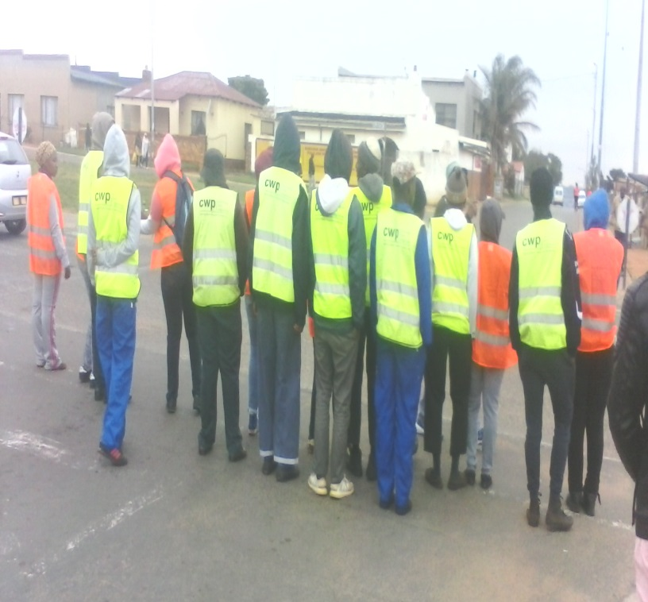
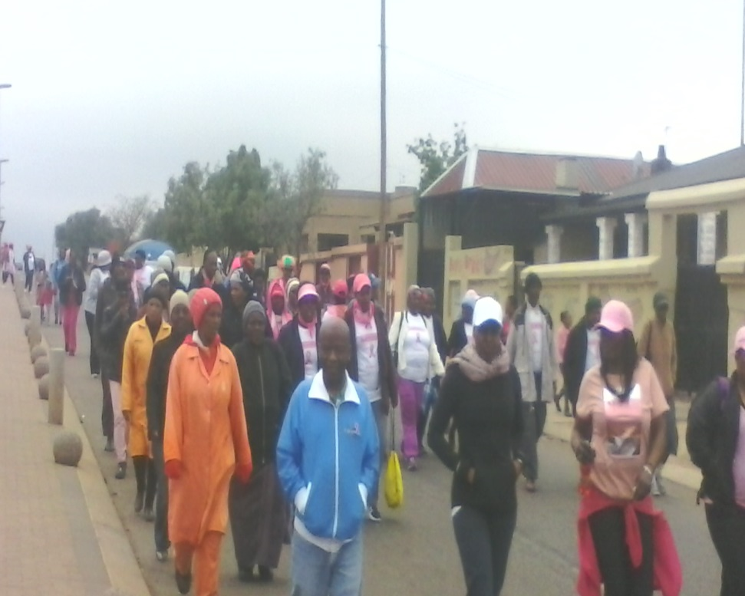
WALK

Slide 23
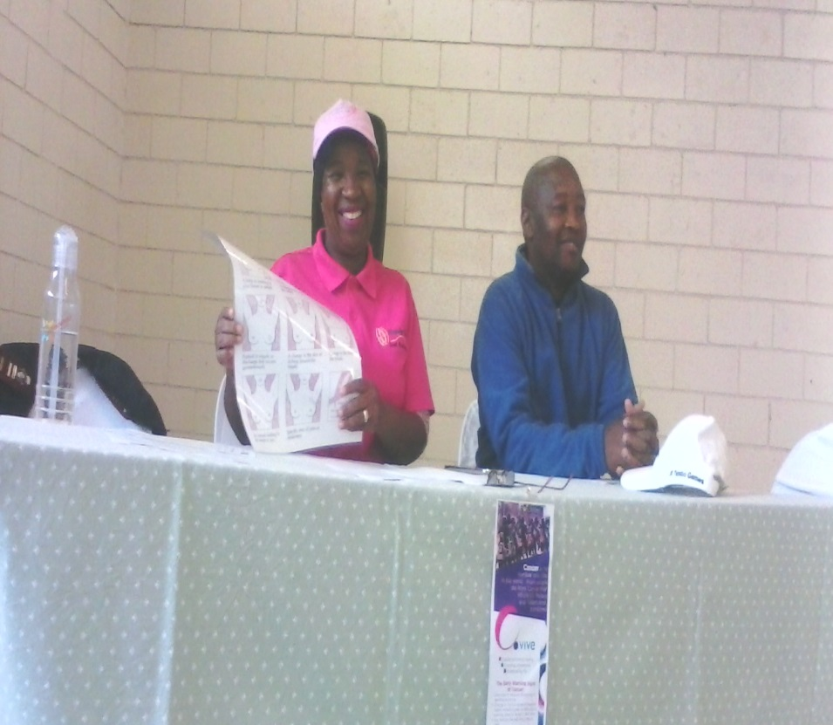
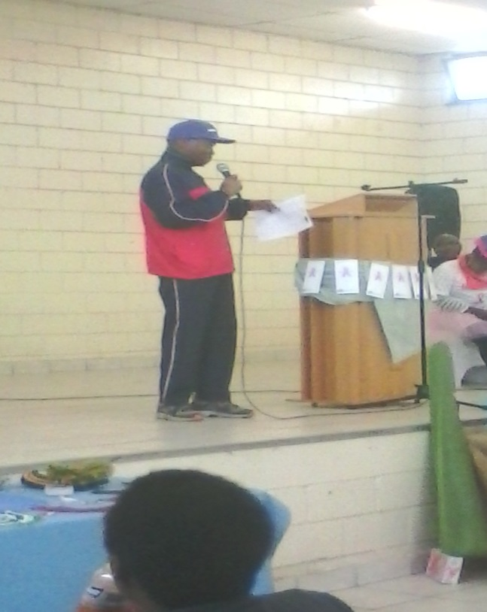
EXECUTIVE MAYOR
NURSE & COUNCILLOR

Slide 24
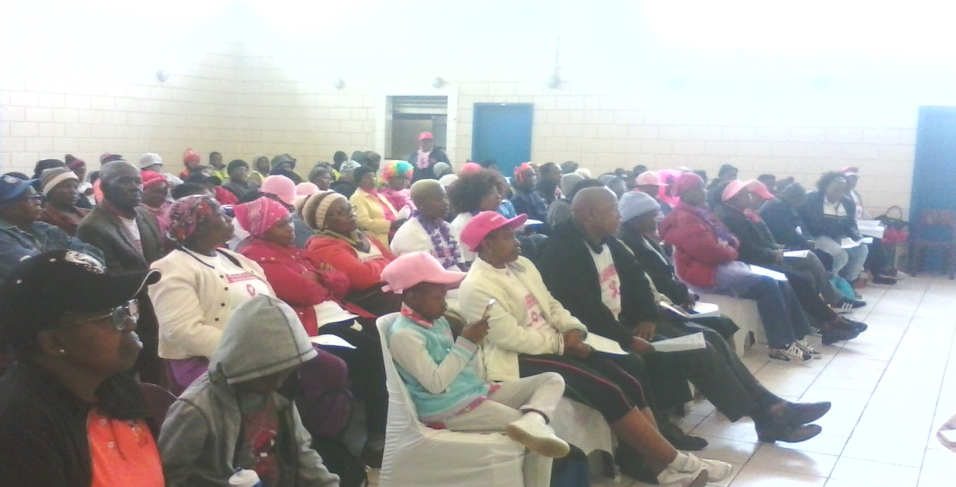
AUDIENCE

Slide 25
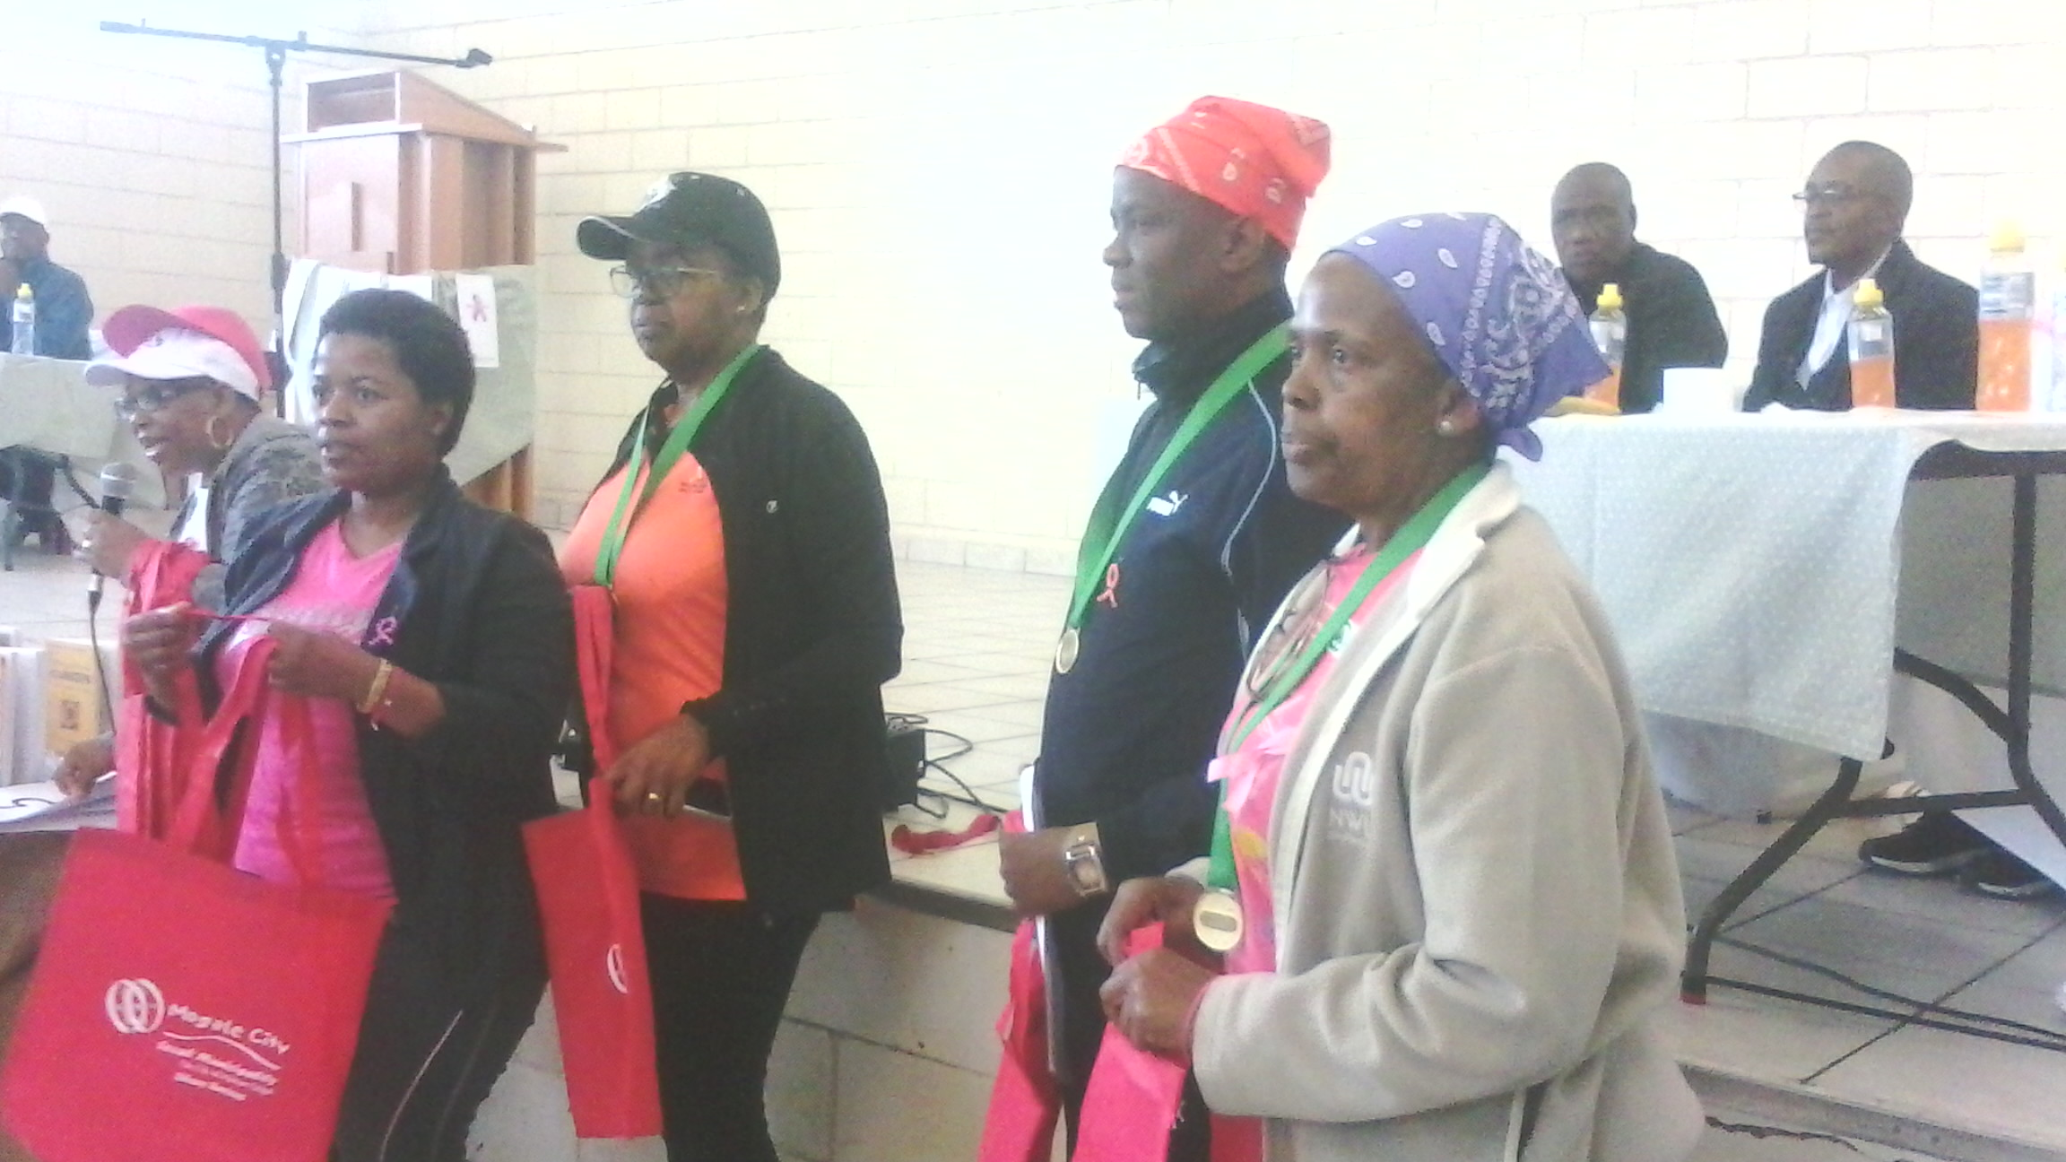

Slide 26
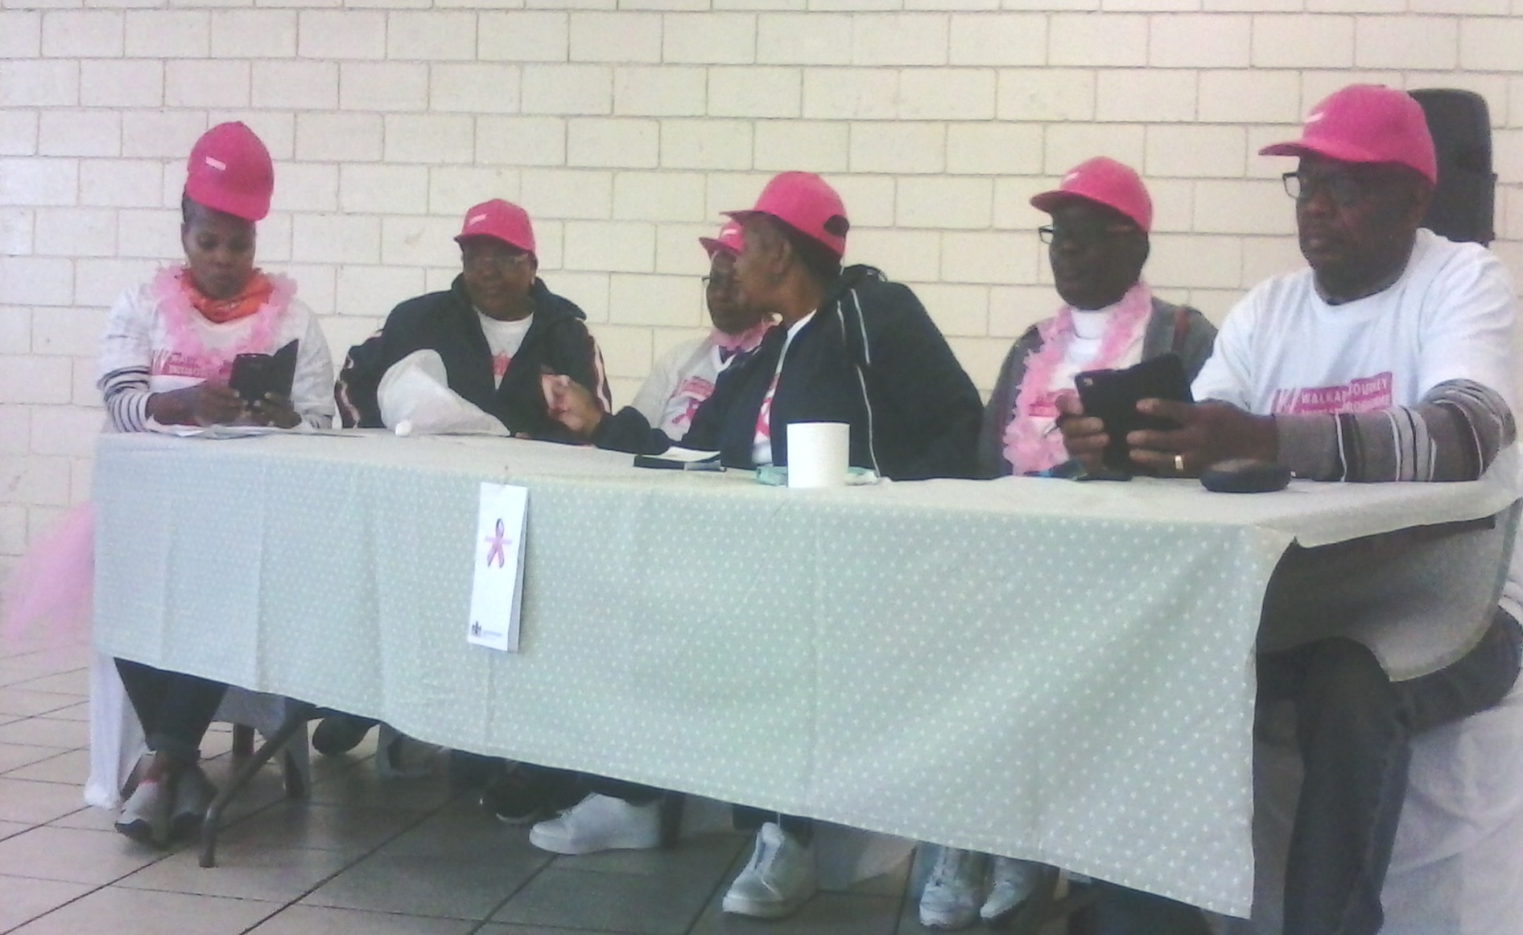
EXECUTIVE

